Slide 1
DIYALA UNIVERSITY COLLEGE OF ENGINEERING DEPARTMENT OF COMMUNICATION ENGINEERING
Electronic Circuits II
Second Year_ Lecture 3
lecturer
Wisam Hayder
2021

Slide 2
5. RC Coupled Transistor Amplifier
This is the most popular type of coupling because it is cheap and provides excellent audio fidelity over a wide range of frequency.
It is usually employed for voltage amplification. Fig. 11.9 below shows two stages of an RC coupled amplifier.
A coupling capacitor $C_{C}$ is used to connect the output of first stage to the base (i.e. input) of the second stage and so on.
As the coupling from one stage to next is achieved by a coupling capacitor followed by a connection to a shunt resistor, therefore, such amplifiers are called resistance - capacitance coupled amplifiers.
Notes:
aaa

Slide 3
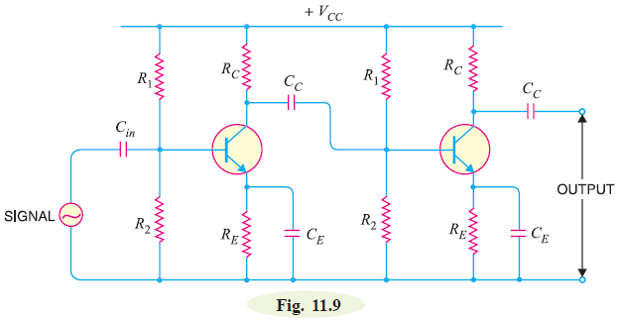
5. RC Coupled Transistor Amplifier
Notes:
aaa

Slide 4
5. RC Coupled Transistor Amplifier
The resistances $R_{1}$ , $R_{2}$ and $R_{E}$ form the biasing and stabilization network.
The emitter bypass capacitor offers low reactance path to the signal.
Without it, the voltage gain of each stage would be lost.
The coupling capacitor $C_{C}$ transmits a.c. signal but blocks d.c. This prevents d.c. interference between various stages and the shifting of operating point.
Notes:
aaa

Slide 5
5. RC Coupled Transistor Amplifier
Operation. When a.c. signal is applied to the base of the first transistor, it appears in the amplified form across its collector load $R_{C}$.
The amplified signal developed across $R_{C}$is given to base of next stage through coupling capacitor $C_{C}.$
The second stage does further amplification of the signal.
In this way, the cascaded (one after another) stages amplify the signal and the overall gain is considerably increased.
Notes:
aaa

Slide 6
5. RC Coupled Transistor Amplifier
It may be mentioned here that total gain is less than the product of the gains of individual stages.
It is because when a second stage is made to follow the first stage, the effective load resistance of first stage is reduced due to the shunting effect of the input resistance of second stage.
This reduces the gain of the stage which is loaded by the next stage.
Notes:
aaa

Slide 7
5. RC Coupled Transistor Amplifier
For instance, in a 3-stage amplifier, the gain of first and second stages will be reduced due to loading effect of next stage.
However, the gain of the third stage which has no loading effect of subsequent stage, remains unchanged.
The overall gain shall be equal to the product of the gains of three stages.
Notes:
aaa

Slide 8
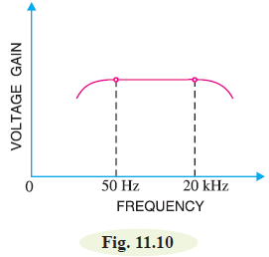
5. RC Coupled Transistor Amplifier
Frequency response. Fig. 11.10 below shows the frequency response of a typical $R_{C}$coupled amplifier.
It is clear that voltage gain drops off at low (< 50 Hz) and high (> 20 kHz) frequencies whereas it is uniform over mid-frequency range (50 Hz to 20 kHz).
Notes:
aaa

Slide 9
5. RC Coupled Transistor Amplifier
This behavior of the amplifier is briefly explained below:
(i) At low frequencies (< 50 Hz), the reactance of coupling capacitor $C_{C}$is quite high and hence very small part of signal will pass from one stage to the next stage.
Moreover, $C_{E}$ cannot shunt the emitter resistance $R_{E}$ effectively because of its large reactance at low frequencies.
These two factors cause a falling of voltage gain at low frequencies.
Notes:
aaa

Slide 10
5. RC Coupled Transistor Amplifier
(ii) At high frequencies (> 20 kHz), the reactance of $C_{C}$is very small and it behaves as a short circuit.
This increases the loading effect of next stage and serves to reduce the voltage gain. Moreover, at high frequency, capacitive reactance of base-emitter junction is low which increases the base current.
This reduces the current amplification factor β.
Due to these two reasons, the voltage gain drops off at high frequency.
Notes:
aaa

Slide 11
5. RC Coupled Transistor Amplifier
(iii) At mid-frequencies (50 Hz to 20 kHz), the voltage gain of the amplifier is constant.
The effect of coupling capacitor in this frequency range is such so as to maintain a uniform voltage gain.
Thus, as the frequency increases in this range, reactance of $C_{C}$ decreases which tends to increase the gain. However, at the same time, lower reactance means higher loading of first stage and hence lower gain.
These two factors almost cancel each other, resulting in a uniform gain at mid-frequency.
Notes:
aaa

Slide 12
5. RC Coupled Transistor Amplifier
Advantages
(i) It has excellent frequency response. The gain is constant over the audio frequency range which is the region of most importance for speech, music etc.
(ii) It has lower cost since it employs resistors and capacitors which are cheap.
(iii) The circuit is very compact as the modern resistors and capacitors are small and extremely light.
Notes:
aaa

Slide 13
5. RC Coupled Transistor Amplifier
Disadvantages
(i) The RC coupled amplifiers have low voltage and power gain. It is because the low resistance presented by the input of each stage to the preceding stage decreases the effective load resistance (RAC) and hence the gain.
(ii) They have the tendency to become noisy with age, particularly in moist climates.
(iii) Impedance matching is poor.
Notes:
aaa

Slide 14
5. RC Coupled Transistor Amplifier
It is because the output impedance of RC coupled amplifier is
several hundred ohms whereas the input impedance of a
speaker is only a few ohms.
Hence, little power will be transferred to the speaker.
Notes:
aaa

Slide 15
5. RC Coupled Transistor Amplifier
Applications
The RC coupled amplifiers have excellent audio fidelity over a wide range of frequency. Therefore, they are widely used as voltage amplifiers e.g. in the initial stages of public address system.
If other type of coupling (e.g. transformer coupling) is employed in the initial stages, this results in frequency distortion which may be amplified in next stages. However, because of poor impedance matching, RC coupling is rarely used in the final stages.
Notes:
aaa

Slide 16
5. RC Coupled Transistor Amplifier
Note.
When there is an even number of cascaded stages (2, 4, 6 etc), the output signal is not inverted from the input.
When the number of stages is odd (1, 3, 5 etc.), the output signal is inverted from the input.
Notes:
aaa

Slide 17
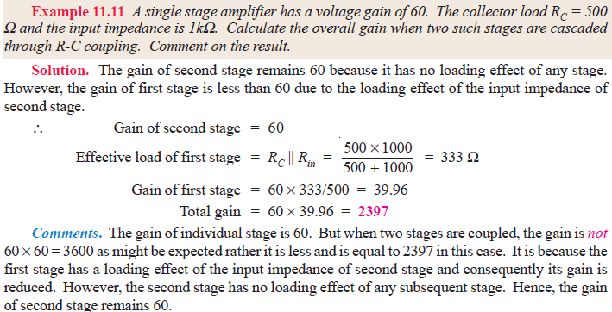
5. RC Coupled Transistor Amplifier
Notes:
aaa

Slide 18
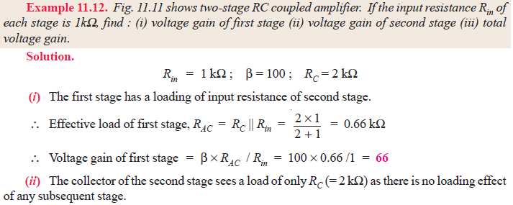
5. RC Coupled Transistor Amplifier

Slide 19
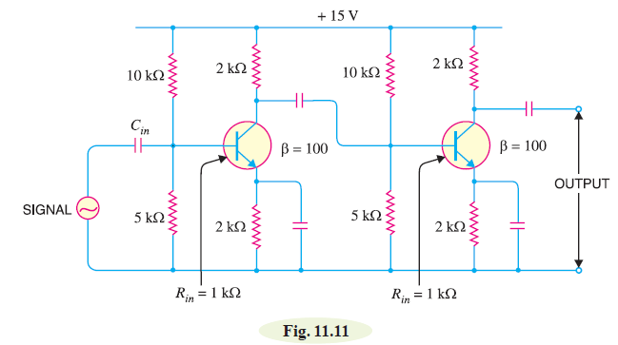
5. RC Coupled Transistor Amplifier

